Slide 1
Merlot Client Information System

Slide 2
Role in team
Students:
Len Bekker (u11026953) – GitHub documentation, API services, Client tests
Kearabiloe Nare (u10068083) – Server display, Server feedback, Database functions
Reinhardt Eiselen (u14043302) – Terminal functions, Code modulation, Landing page
Mpho Mashaba (u14309999) – Database triggers, Server testing, Code review
Ryan Hartley (u15016880) – Database schema, Database testing, Admin

Slide 3
Project Management
We have created a project on GitHub which has 4 columns being :
To do - Tasks still needing to be done
In Progress – Tasks currently being handled
In Review – After completion, the task needs to be reviewed before it can be considered done.
Done – Once a person other than the one who worked on a task reviews the work, it will be moved to the “Done” column meaning that the task is complete.

Slide 4
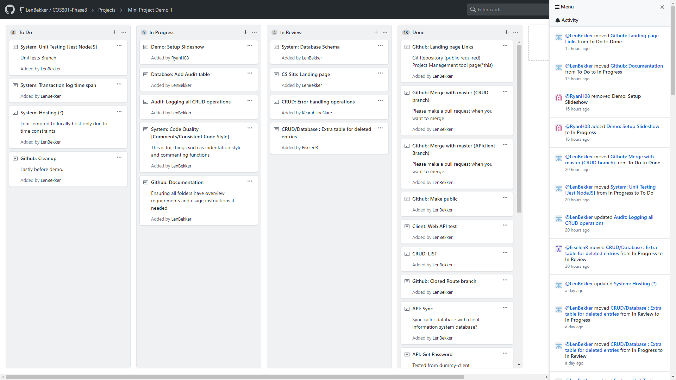
Project Management

Slide 5
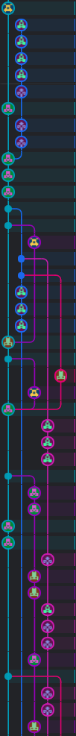
GIT Structure
There is a master folder for which the completed aspects of the project appear.
New branches are created when an update needs to be made. Once the new work has been uploaded, a pull request is issued so that the work in the branch can be reviewed.
Once the updated task has been reviewed and verified, it will then be merged with the master folder.

Slide 6
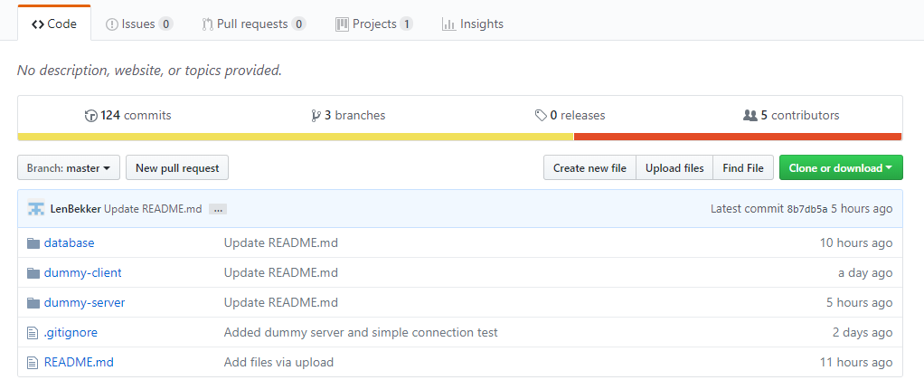
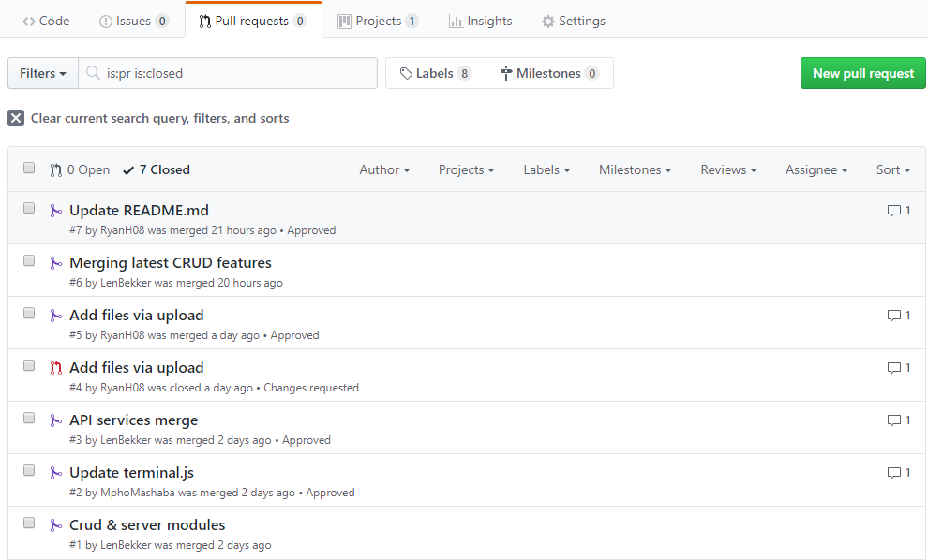
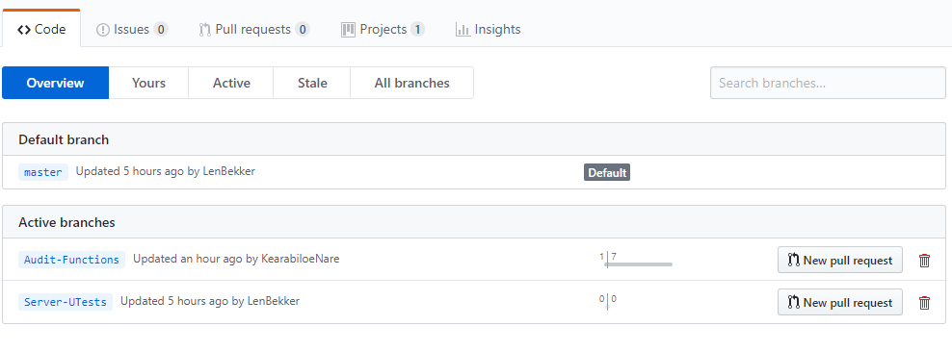
GIT Structure

Slide 7
Unit testing
All unit testing has been done through the terminal. When the server is run, the user is presented with a list of available options corresponding to the design specifications for this project. The user then chooses option he/she would like to perform. If successful, the console will display the alterations made to the database, if not an error message will be displayed. The database itself will also be checked to ensure that the action has happened successfully.

Slide 8
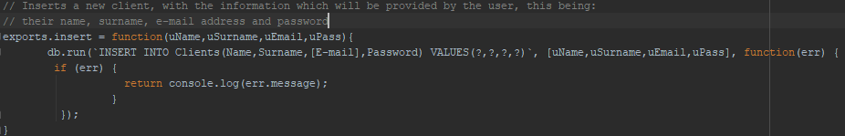
Unit testing
Use case 1 creating(insert) a new user.

Slide 9
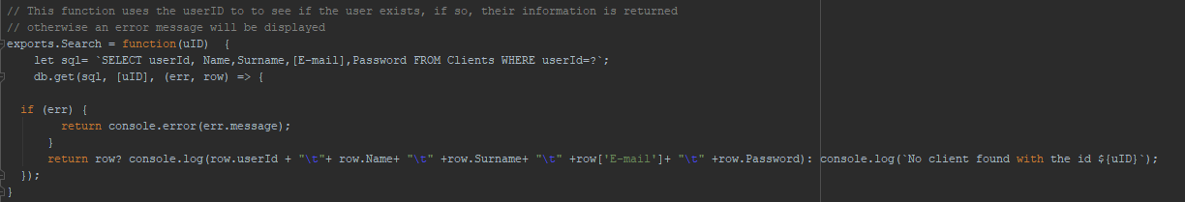
Unit testing
Use case 2, reading(search) for a user.

Slide 10
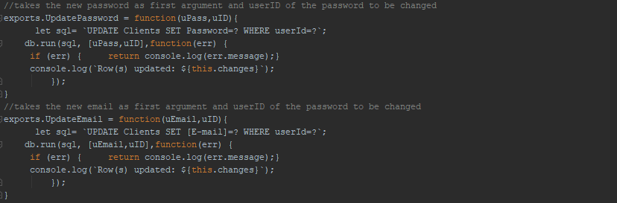
Unit testing
Use case 3, updating existing users information.

Slide 11
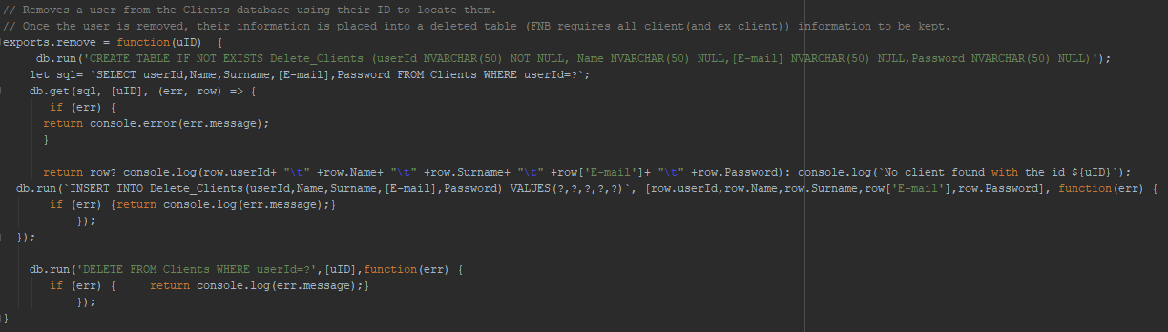
Unit testing
Use case 4, deleting a user from the clients database.

Slide 12
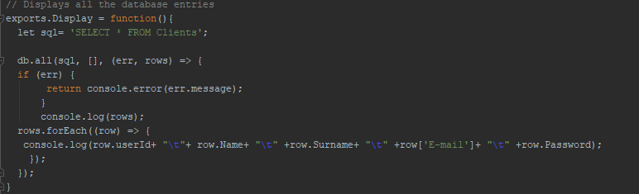
Unit testing
Use case 5, displays all database entries.

